Slide 1
The Constitution
Government

Slide 2
Philosophers who influenced the U.S. Constitution
John Locke, Montesquieu, Rousseau, William Blackstone
Natural Rights
Social Contract
Separation of Powers
Checks and Balances

Slide 3
Framers of Constitution
Delegates to the Constitutional Convention
Many had fought in the Revolution
46 were members of the Continental Congress
Most were younger men
James Madison, primary architect of document, was only 35

Slide 4
Rules of Procedure
George Washington was president of the Convention
A majority of states were needed to conduct business
Each state delegation had one vote
Met in Philadelphia State House (Independence Hall) from May 25 through September 17. 92 of 116 days were spent working
The Constitution was to replace the Articles of Confederation

Slide 5
Virginia Plan
Mostly the work of James Madison and Edmund Randolph
Called for three branches-executive, legislative, and judicial
The legislature would be bicameral-two houses
Representatives would be chosen by popular vote and Senators would be chosen by the state legislatures nominating people.
Would give National law power over state law
Congress would choose a National Executive and National Judiciary
Congress would have exclusive power to admit new states

Slide 6
New Jersey Plan
Would retain Unicameral house
Power to tax and regulate trade between states
A federal executive of more than one person chosen by Congress. This executive could be removed at the request of a majority of the states' governors.
One single supreme court appointed b the executive

Slide 7
Differences
How would states be represented?
Virginia-financial contributions and state population
New Jersey-State equality

Slide 8
Connecticut Compromise
To end deadlock, Connecticut delegates Sherman, Ellsworth and Johnson presented this compromise
Legislature would be two houses. House of Representatives would be based on state population and the Senate would have equal representation

Slide 9
Three-Fifths Compromise
Should enslaved people be counted as part of the population?
The most of the South argued yes it should.
The compromise allowed the Southern States to count three fifths of the slave population, but they would have to pay a tax to do so.
This was abolished with the adoption of the 13th Amendment in 1865.

Slide 10
Commerce and Slave Trade Compromise
Southern states were fearful Northern put export duties on Sothern crops and interfere with the slave trade.
Congress was forbidden to tax the export of goods from any state
Congress could not interfere with the slave trade for a period of 20 years.

Slide 11
Constitution in its final form
Convention approved the document on September 17
Ratification became a difficult matter
Federalists supported ratification and Anti-Federalists opposed it.
The biggest point of contention was a lack of Bill of Rights written into the Constitution. Most of the these rights were in state constitutions.
The Federalist, written by Madison, Hamilton, and John Jay, was a collection of commentary and essays in support of ratification, which was published in all 13 states. It is still a great example of excellent political writing and thought.

Slide 12
Road to Ratification
June 21, 1788 New Hampshire brought the number of states ratifying the Constitution to nine.
Virginia and New York followed, bringing the number to 11 allowing Congress to be formed and convene in the temporary capital of New York City on March 4, 1789.
George Washington was chosen as the first president, and John Adams was chosen as the first vice-president

Slide 13
Chapter 3-The Constitution
Preamble-States the purpose of the Constitution
Article I: Creates the Legislative Branch
Article II: Creates the Executive Branch
Article III: Creates the Judicial Branch
Article IV: Relations among the States
Article V: Amending the Constitution
Article VI: National debts, supremacy of national law, and oaths of office
Article VII: Ratifying the Constitution

Slide 14
Article 1-Legislature
Establishes a bicameral legislature
Historical precedent-The British Parliament was bicameral, and most of the colonial legislatures were bicameral
This form was adopted as a compromise between the Virginia and New Jersey Plan. It became an example of federalism; House of Reps based on state population and equal representation in the Senate.
Also, most Framers liked the bicameral model because one House could act as a check on the other
Washington: "We pour legislation into the Senatorial saucer to cool it."

Slide 15
Article II: The Executive
"The executive Power shall be vested in a President of the United States of America." Section 1
Command armed forces
Make treaties
Approve or veto acts of Congress
Call special sessions of Congress
Receive foreign diplomats
"take Care that the Laws be faithfully executed."
Executive defined in broad terms. We have struggled to understand the extent of 'executive power.'

Slide 16
Article III: The Judicial Branch
With the Articles, the states interpreted federal law. No national judiciary.
Hamilton said laws are "dead letter without courts to expound and define on their true meaning and operation."
"The judicial Power of the United States shall be vested in one supreme Court, and in such inferior courts as the Congress may from time to time ordain and establish." Section 1
Inferior court: lower federal courts under the Supreme Court. Constitutional courts and special courts.
Constitutional Courts: Court of Appeals, district courts, U.S. Court of International Trade.
Special Courts: U.S. court of Appeals for the Armed Forces, U.S. Tax Court, etc.

Slide 17
Basic Principles
Popular Sovereignty: People are the only source for any and all governmental power
Limited Government: The government is not all-powerful and only has the power to do what the people want them to do.
Constitutionalism: The government must obey the law (rule of law). The Constitution is a statement of limited government.
Separation of Powers: basic powers are distributed among the three branches of government.

Slide 18
More Basic Principles
Checks and Balances: Each branch is subject to restraints by other branches
Congress can pass a law, but the President can veto it. Congress can refuse to approve funds requested by the President, and the Senate can reject a treaty or appointment made by the President.
Judicial Review: The power a court has to declare a government action unconstitutional or illegal.
Federalism: The division of power between the national government and the state governments.

Slide 19
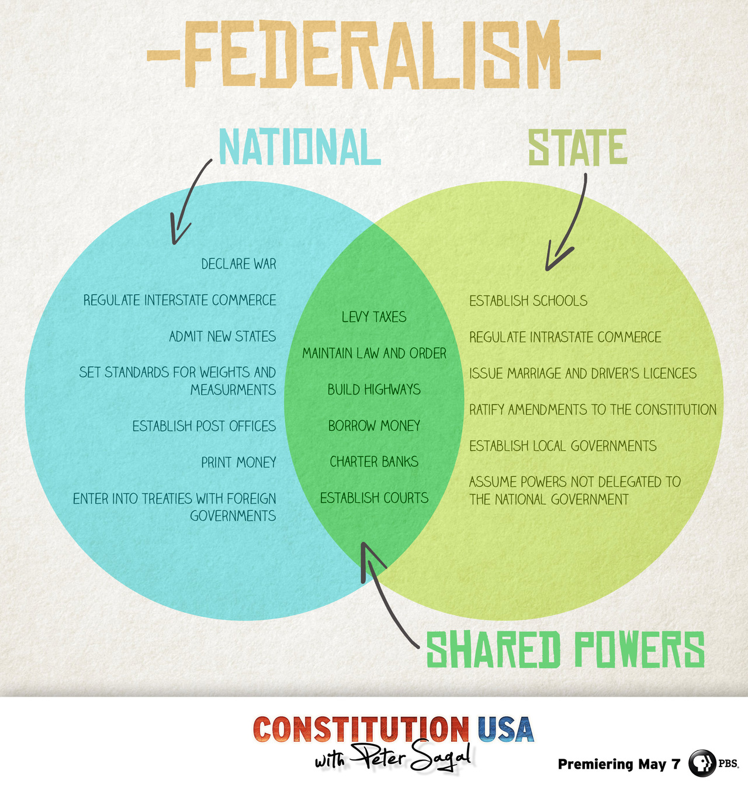
Federalism Diagram
Here are separate and concurrent powers

Slide 20
Amending the Constitution
Amendment-changes to the Constitution
Ratification of Amendments-set forth in Article V
Four methods of formal amendments
An amendment may be proposed by two-thirds vote in each house of Congress and ratified by three-fourths of the state legislatures (38 state legislatures). Of the 27 amendments, 26 have been done this way.
An amendment may be proposed by Congress and ratified by conventions called for that purpose on three-fourths of the states. Only the 21st Amendment was passed this way (1933). The thought was state conventions would be better to reflect the will of the people.

Slide 21
Amending the Constitution
An amendment may be proposed by a national convention called by Congress at the request of two-thirds of the state legislatures (34 states). The amendment must then be ratified by three-fourths of the state legislatures.
Lastly, an amendment may be proposed by a national convention and then ratified in three-fourths of the state conventions.

Slide 22
Proposing an Amendment
If a state rejects a proposed amendment, it is not forever bound to that action.
The state may later ratify the amendment
The reverse, however, is not true.
Congress sets a reasonable time limit for ratification. 18th Amendment- 7 year period.

Slide 23
27 Amendments
1-10: Bill of Rights
11th Amendment: A state cannot be sued by someone out of state or by a foreign entity.
12th: Changes t the process of electing the President through the Electoral College
13th: Abolished slavery
14th: granting citizenship to freed slaves
15: giving the right to vote to African-American males
18th: Prohibition of Alcohol. Repealed by the 21st
22: Limits presidents to two terms
26: Members of Congress cannot raise their pay during that term.

Slide 24
Change by other means
Basic Legislation
Executive Action
Court Decisions
Party Practices-electoral college
Custom and Usage- Cabinet; senatorial courtesy

Slide 25
Federalism
Division of government on a territorial basis. This creates a dual system of government
Ex- Division of powers between Washington D.C. (Central) and State (Michigan) governments.
Powers not assigned to Federal government is reserved to the states-10th Amendment.

Slide 26
Three Types of Federal Powers
Delegated powers- powers granted to the Federal government by the Constitution
Expressed Powers- Powers that are 'spelled out' expressly-these are also called enumerated powers
Implied Powers-powers not expressly stated, but reasonably suggested
Ex-Congress has the power to make all laws which shall be necessary and proper for carrying into Execution the foregoing Powers and all other Powers vested by this Constitution in the Government of the United States or in any Department or Officer thereof. Article I Sec. 8 Clause 18
Inherent-powers the National government has because of sovereignty. Power to regulate immigration

Slide 27
Powers denied
Levy taxes on exports
Take private property with out payment
Prohibit freedom of speech, religion, press, or assembly
Conduct illegal search and seizure
Deny speedy trial to an accused person

Slide 28
Powers of states
Reserved powers- 10th Amendment
Licensure of doctors, lawyers, teachers
Allowing legal gambling
Use of land
All of these are not expressly stated or implied in the Constitution.

Slide 29
Powers denied to states
Treaties with foreign nations
Coin money
Cannot tax agencies or functions of national government

Slide 30
Exclusive and Concurrent powers
Exclusive powers- power that can be exercised by the Federal Government alone. Ex- coining money, regulating interstate commerce
Concurrent powers- powers both the Federal government and state governments exercise. Ex- levy and collect taxes, define crimes and set punishment (ex-death penalty).

Slide 31
Supremacy Clause
Article 6, clause 2
The Constitution is the supreme law of the land, ranking above state law in a case of conflict between the two parties.

Slide 32
Section 4 Ch. 3
Constitution requires the national government to guarantee certain things to the states
Make it possible for the federal government to do certain things for the states
Ex- The Federal government will protect all 50 states in case of an invasion.
Respect for territorial integrity

Slide 33
Admission of New States
Only Congress can do this
Cannot create a state by taking territory away from a state or states without approval.
Procedure: 1. Area wanting statehood asks Congress for admission. 2 Congress then passes an enabling act, to have the area form a state constitution. A convention prepares the constitution for approval within the territory. 3. If the voters approve, it then goes to Congress for consideration. If Congress approves, it passes an act of admission. If the President signs the act, then the new State enters the Union.

Slide 34
Grants-in-aid Programs
Federal money given to states, local governments to help them operate if they are hurting for money to operate. Ex- Morrill Act of 1862-Land-grant colleges.
More than 500 in operation today
Total of around $400 billion- accounts for a third of state and local spending each year.

Slide 35
Categorical Grants
Money given for a specific purpose
Ex- money given to construct an airport. Money can only be used for this manner.
State or local government must contribute funds
Provide an agency to administer grant
Obey guidelines of grant

Slide 36
Block grants
Much more broadly defined- not as specific as categorical grants
Ex-health care, social services, welfare
Fewer strings attached than the categorical grant
Gives the state greater freedom on how to spend the grant

Slide 37
Project grants
Given to state, local governments, and private agencies who apply for grants.
Ex-grant given to scientists (who apply for the grant) to study cancer. The grant is given through the Department of Health and Human Services.

Slide 38
Other forms of Federal Aid
FBI aiding local law enforcement
U.S. Air Force quipping Air National Guard
Places with large federal landholdings get payments in lieu of property taxes
State Aid to federal gov't: local workers helping work elections, naturalization of new citizens

Slide 39
Agreements among States
Interstate compacts: agreements among states or foreign countries with the approval of Congress
Full faith and credit shall be given in each state to the public acts, records, and judicial proceedings of every other state. Ex- if you lose a court case and have to pay $50,000 in Michigan, you cannot move to Ohio to get out of paying the judgment.
Exceptions:
Applies to civil, not criminal matters. Ohio cannot enforce Michigan criminal law
Marriage and Divorce

Slide 40
Extradition
Article IV, Sec.2, Clause 2
If a fugitive escapes a state and goes to another state to evade justice, the Governor of the state to which the fugitive escaped can return (extradite) the fugitive back to the state in which the crime was committed.

Slide 41
Privileges and Immunities Clause
Article 4, Section 2, Clause 1
Citizens of each state shall be entitled to all the privileges and immunities of citizens in several states.
A governor cannot order employers to hire only in-state employees.
A state can require someone to live in state for period of time before they run for elected office.

